Slide 1
The Maximum density still life

Slide 2

Conway's Game of Life
The Game of Life (an example of a cellular automaton) is played on an infinite two-dimensional rectangular grid of cells. Each cell can be either alive or dead. The status of each cell changes each turn of the game (also called a generation) depending on the statuses of that cell's 8 neighbors. Neighbors of a cell are cells that touch that cell, either horizontal, vertical, or diagonal from that cell.

Slide 3

The configuration of live and dead cells at time t leads to a new configuration at time t+1 according to the rules of the game:
if a cell has exactly three living neighbours at time t, it is alive at time t+1
if a cell has exactly two living neighbours at time t it is in the same state at time t+1 as it was at time t
otherwise, the cell is dead at time t+1

Slide 4


Patterns
Many different types of patterns occur in the Game of Life, which are classified according to their behaviour. Common pattern types include:
still lifes, which do not change from one generation to the next;
oscillators, which return to their initial state after a finite number of generations;
spaceships, which translate themselves across the grid.

Slide 5
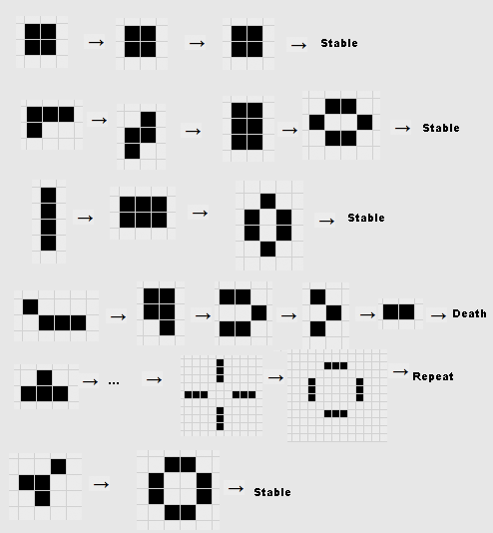

Slide 8
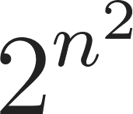
The Maximum Density Still Life Problem
The Maximum Density Still Life Problem is to find the maximum number
of live cells that can fit in an n × n region of an infinite board, so that the board is stable
under the rules of Conway’s Game of Life. It is considered a very difficult problem and
has a raw search space of O( ) .
▢ ▢ ▢ ▢ ▢ ▢ ▢
▢ ▢ ▢ ▢ ▢ ▢ ▢
▢ ▢ ▩ ▩ ▢ ▢ ▢
▢ ▢ ▩ ▢ ▩ ▢ ▢
▢ ▢ ▢ ▩ ▩ ▢ ▢
▢ ▢ ▢ ▢ ▢ ▢ ▢
▢ ▢ ▢ ▢ ▢ ▢ ▢

Slide 9
▢ ▢ ▢ ▢ ▢ ▢ ▢ ▢ ▢ ▢ ▢ ▢ ▢ ▢
▢ ▢ ▢ ▢ ▢ ▢ ▢ ▢ ▢ ▢ ▢ ▢ ▢ ▢
▢ ▢ ▩ ▩ ▢ ▩ ▩ ▢ ▩ ▩ ▢ ▩ ▢ ▢
▢ ▢ ▩ ▩ ▢ ▩ ▩ ▢ ▩ ▢ ▩ ▩ ▢ ▢
▢ ▢ ▢ ▢ ▢ ▢ ▢ ▢ ▩ ▢ ▢ ▢ ▢ ▢
▢ ▢ ▩ ▩ ▩ ▩ ▩ ▩ ▢ ▩ ▩ ▩ ▢ ▢
▢ ▢ ▩ ▢ ▢ ▢ ▢ ▢ ▩ ▢ ▢ ▩ ▢ ▢
▢ ▢ ▢ ▩ ▢ ▩ ▩ ▢ ▩ ▢ ▩ ▢ ▢ ▢
▢ ▢ ▩ ▩ ▢ ▩ ▩ ▢ ▩ ▢ ▩ ▩ ▢ ▢
▢ ▢ ▩ ▢ ▢ ▢ ▢ ▢ ▩ ▢ ▩ ▢ ▢ ▢
▢ ▢ ▢ ▩ ▢ ▩ ▩ ▢ ▩ ▢ ▩ ▢ ▢ ▢
▢ ▢ ▩ ▩ ▢ ▩ ▢ ▩ ▩ ▢ ▩ ▩ ▢ ▢
▢ ▢ ▢ ▢ ▢ ▢ ▢ ▢ ▢ ▢ ▢ ▢ ▢ ▢
▢ ▢ ▢ ▢ ▢ ▢ ▢ ▢ ▢ ▢ ▢ ▢ ▢ ▢
Optimal solution for n = 10

Slide 10
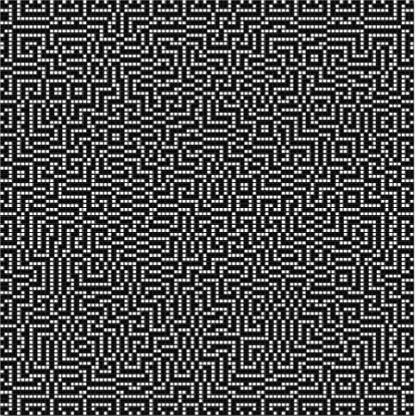
Optimal solution for n = 100

Slide 11
References
CHU, G. AND STUCKEY, P. J.
A complete solution to the Maximum Density Still Life Problem
In-text: (Chu & Stuckey, 2012)
Your Bibliography: Chu, G., & Stuckey, P. (2012). A complete solution to the Maximum Density Still Life Problem. Artificial Intelligence, 184-185, 1-16. https://doi.org/10.1016/j.artint.2012.02.001

